Slide 1

Measuring systemic risks in Armenia: A Growth-at-Risk approach
Central Bank of Armenia

Slide 2
What is it about?
Recent years have seen a rapid operationalization of Macroprudential policy (MP) in many countries. But it still lacks reliable quantitative measurement framework and a criteria for policy rule (as in case of Monetary Policy).
The main problems of MP:
Wide diversity of tools with overlapping coverage
The impact is difficult to quantify
Strong non-linearities in the effects of MP
The absence of a clear and well-defined target

Slide 3
Motivation
Our aim is to tie the decisions of macroprudential policy to current risks and the potential materialization of those risks. As systemic risks accumulate, it is crucial to adjust macroprudential measures accordingly, both to manage these risks and to enhance the resilience of the financial system.
The project aims to:
Quantify current systemic risk (possible shortfall of GDP in case of crisis)
Differentiate between various types of risks (the drivers behind the shortfall)
Examine the impact of MP on these risks
Derive the MP stance given the current level of risks and financial system resilience.

Slide 4
What is Growth-at-Risk?
We focus on GDP growth to quantify and measure how risks affect the overall economy.
In simple terms, Growth-at-Risk framework is used to model the impact of exogenous variables not on the mean value of the dependent variable, but on its entire distribution. To do this, it uses the quantile regression approach (Koenker & Basett, 1978).
The benefits of GaR framework:
Measure short-term costs vs long-term benefits of Macroprudential policy tools
The mean/median of distribution as an indicator of short-term costs
And the improvement in the tail (usually 5th or 10th quantile) as a measure of benefits
Study the non-linear effects of MP on the economy
Help design an intuitive policy decision rule

Slide 5
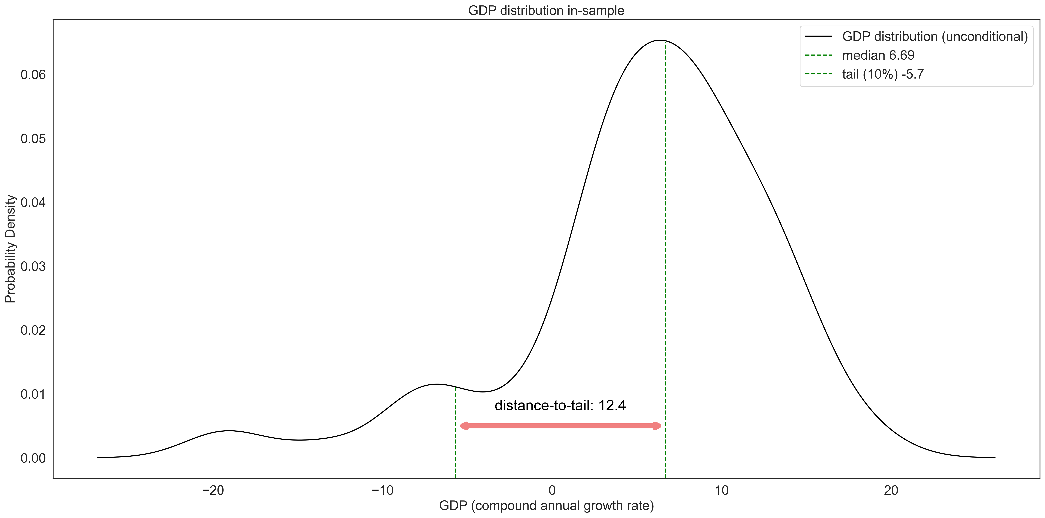
GDP distributions
The distance-to-tail metric conveys the unconditional risks that the system faces. This metric can serve as the main indicator for the macroprudential stance.

Slide 6
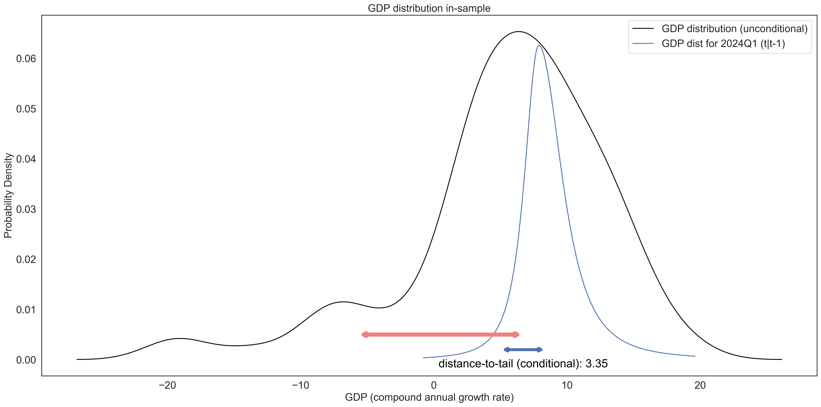
GDP distributions
The conditional distance-to-tail tracks the changes in systemic risk over time. The conditional GDP growth distribution displays how the risks shape the uncertainty of GDP growth expectations.

Slide 7
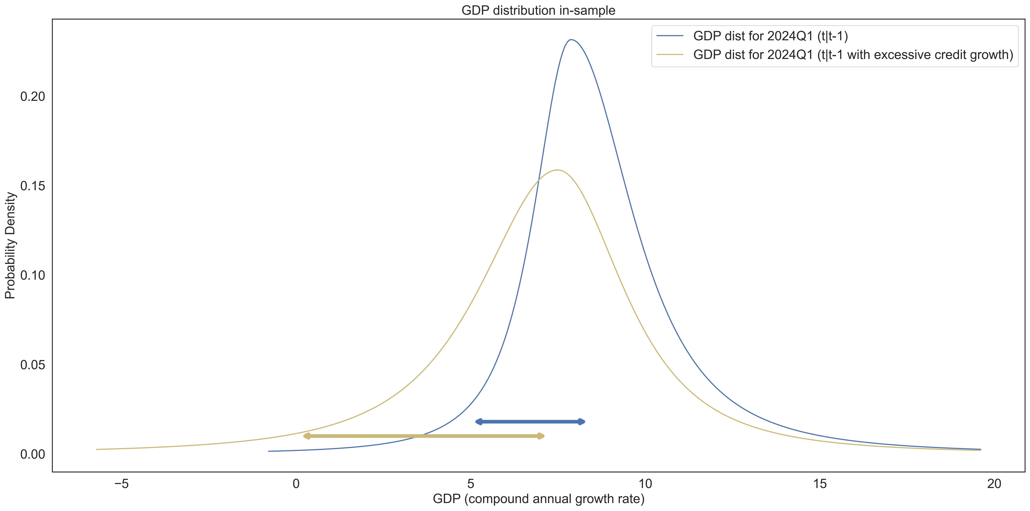
GDP distributions (simulation)
Excessive credit growth a year prior will affect the shape of the distribution. It may increase or decrease the median, but will always negatively affect the tail. The distance-to-tail will sharply increase as a result.

Slide 8
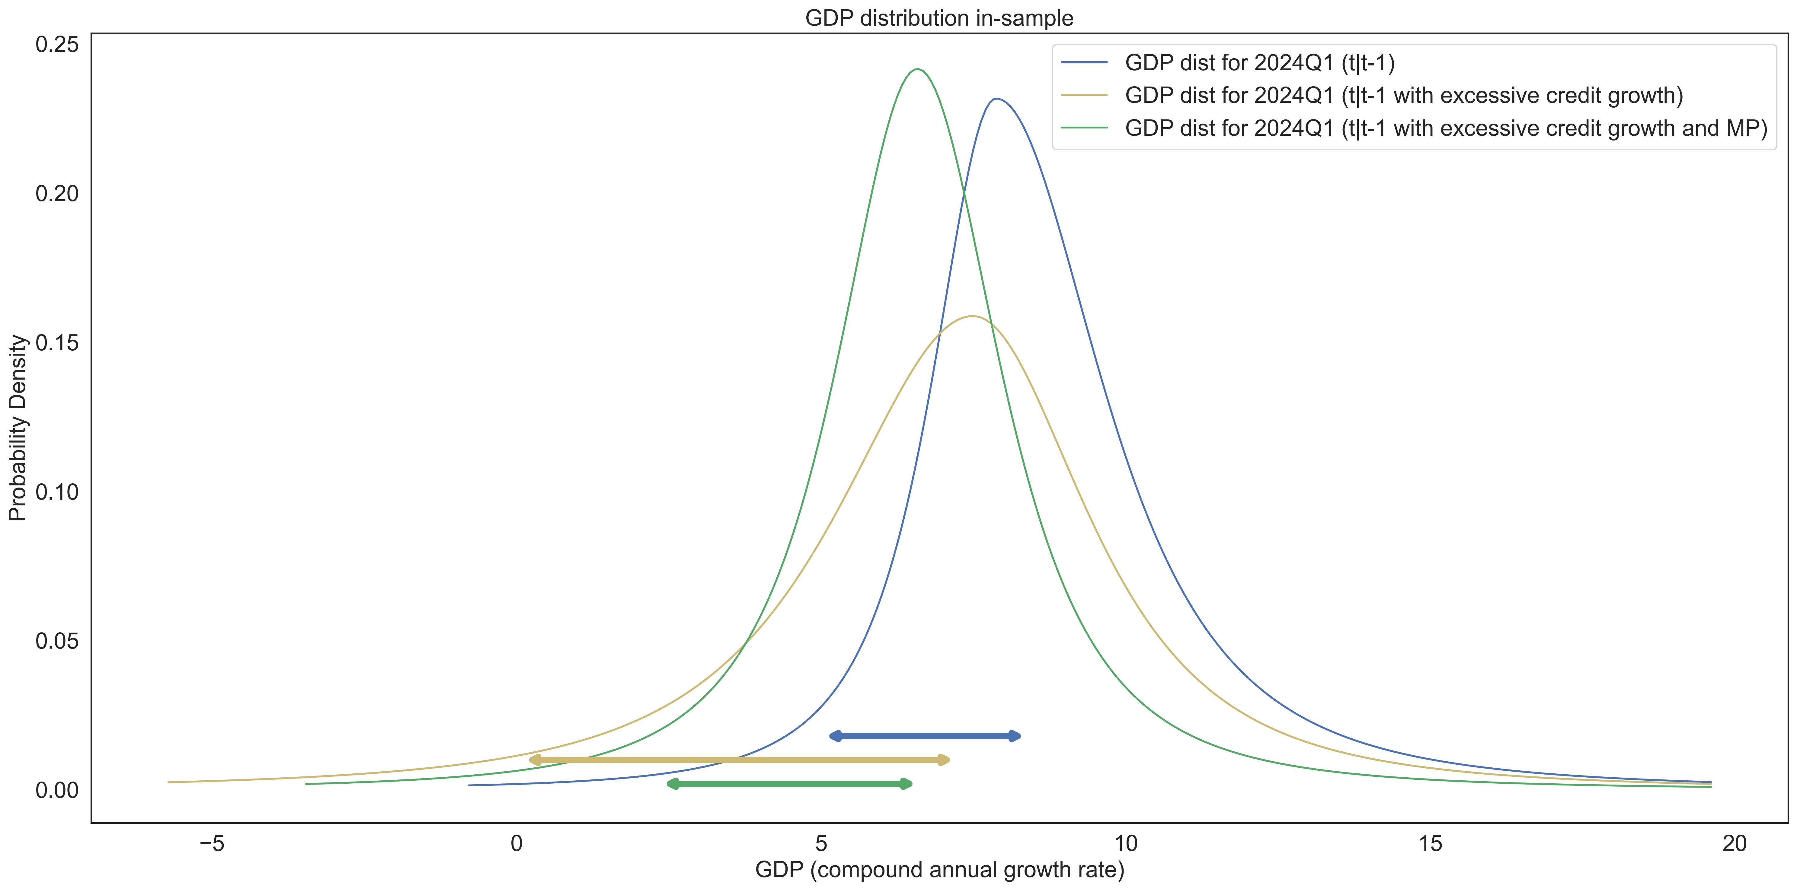
GDP distributions (simulation)
The tightening of macroprudential policy will negatively affect the median, while also improving the tail. As a result, the distance-to-tail (expected risks) will decrease.

Slide 9
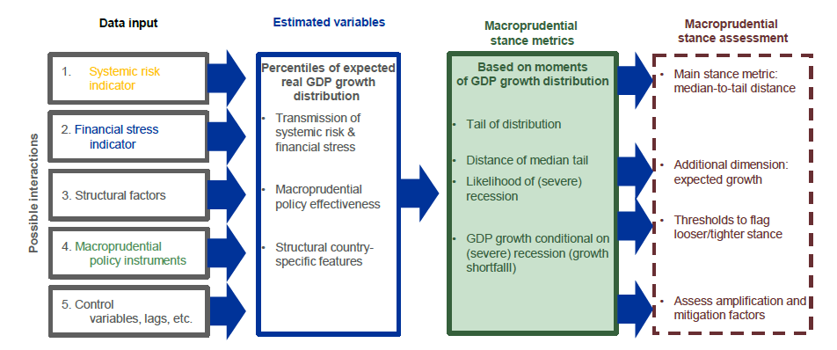
Growth-at-Risk Framework
Data sources:
IMF (FSI and IFS)
World Bank
BIS
TradingView (for Gov bond data)
OECD (house prices)
CBA
Source: ESRB

Slide 10
Key indicators
Financial vulnerability – captures cyclical system risk arising from credit and external imbalances. It has good early warning properties (Lang et al., 2019).
Financial stress – periods in which risks have materialized, reflected in stress episodes with larger asset price volatility, interest rate spreads, and deteriorated risk sentiment. Incorporates variables from financial markets, including interest rates with different maturities (Koop and Korobilis, 2014).
Macroprudential policy index – a dummy variable, where a value of – 1 indicates loosening, +1 tightening and no actions are defined as 0. To account for the persistence in MP tools, a 4 quarter rolling sum is used (Galan, 2020).
Structural variables – includes a range of variables from financial sector, such as indicators for risk absorption capacity (capital, liquidity, profitability ratios), as well as risk-related variables (NPL ratio etc.).
Control variables – variables from macroeconomy

Slide 11
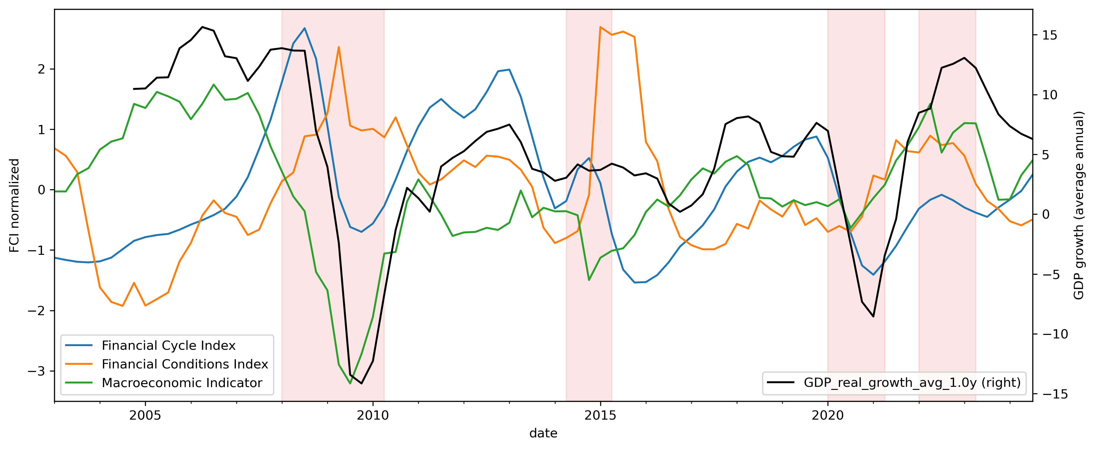
Financial vulnerabilities, stress, external shocks and real GDP growth
The Financial cycle index tracks the risk build-ups in our financial system and is used as a forward looking indicator. The Financial conditions index is meant to show the current tension level in the financial markets. The Macroeconomic indicator captures all other external events that are indirectly related to financial markets.

Slide 12
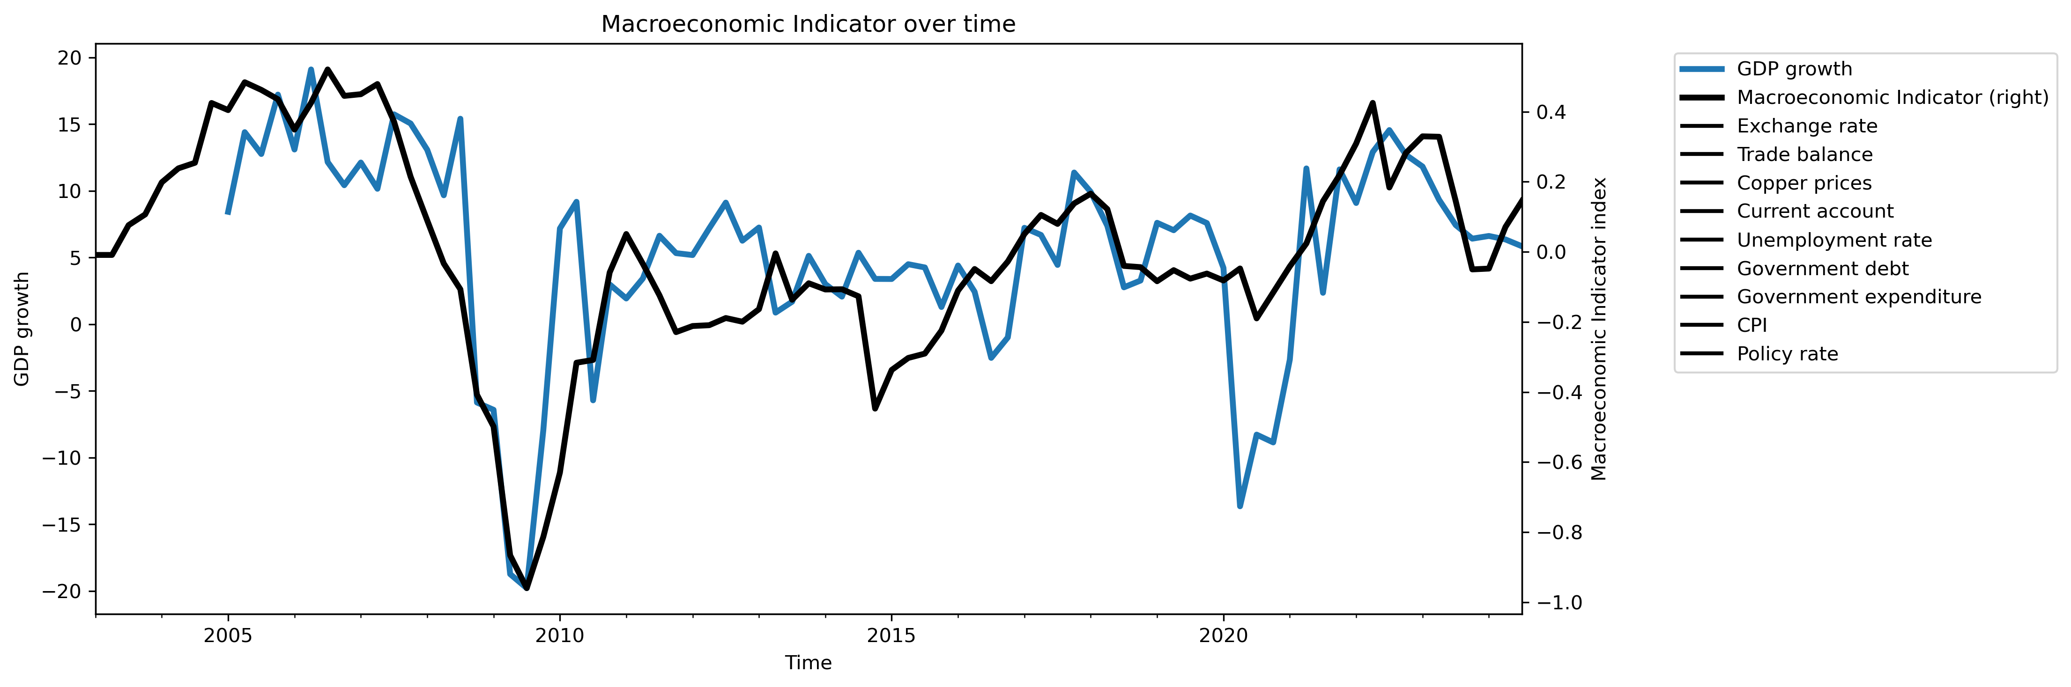
Macroeconomic Indicator
The MI is a composite index that encapsulates key macroeconomic variables, with a focus on external factors critical to the economic performance of a small economy. It incorporates the effects of external demand and supply chain dynamics. It allows for a more holistic assessment of risks to growth.

Slide 13
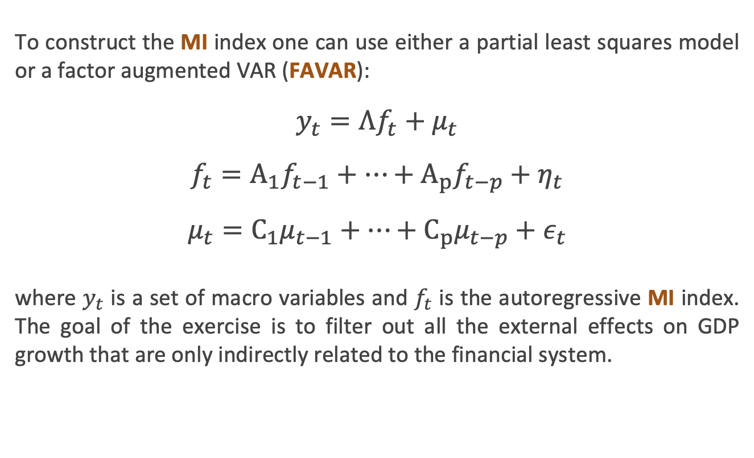
Macroeconomic Indicator: estimation
To construct the MI index one can use either a partial least squares model or a factor augmented VAR (FAVAR):
$$y_{t}=Λf_{t}+μ_{t}$$
$$f_{t}=A_{1}f_{t−1}+…+A_{p}f_{t−p}+η_{t}$$
$$μ_{t}=C_{1}μ_{t−1}+…+C_{p}μ_{t−p}+ε_{t}$$
where $y_{t}$ is a set of macro variables and $f_{t}$ is the autoregressive MI index. The goal of the exercise is to filter out all the external effects on GDP growth that are only indirectly related to the financial system.

Slide 14
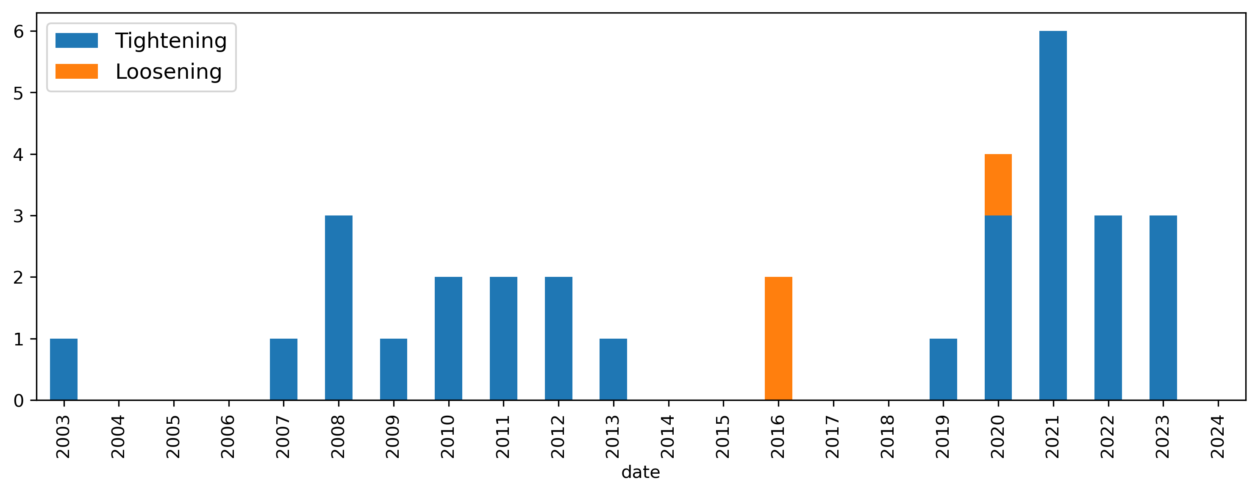
Macroprudential policy usage in Armenia
The MP has been increasingly used after the Great Recession of 2008, yet the MP usage history in Armenia remains short. This remains a major limitation, especially when modeling the effect of loosening actions on growth. To account for this, we perform a panel quantile regression with 42 countries and use those estimates as priors in our local model.

Slide 15
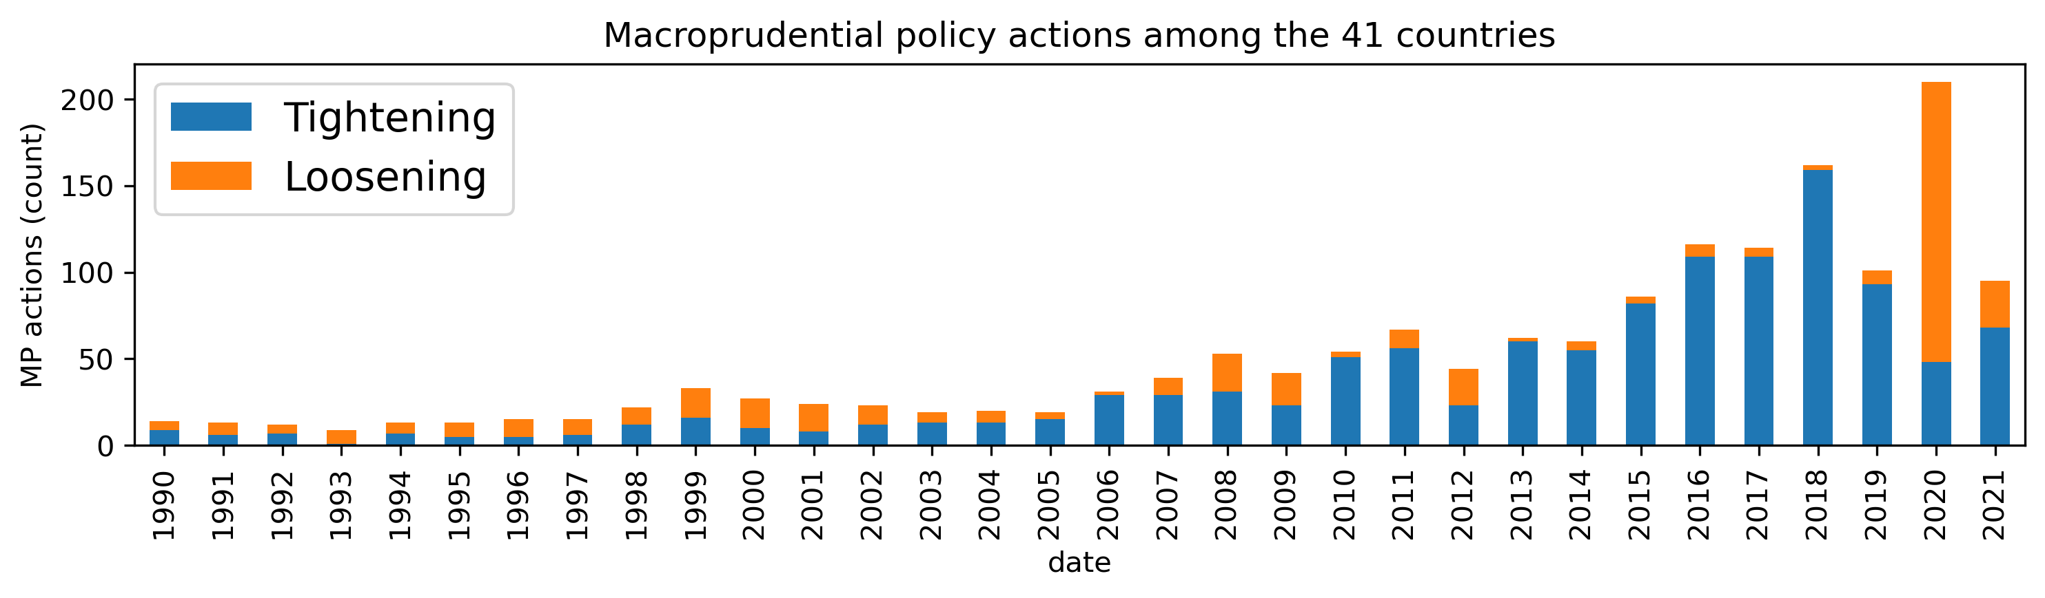
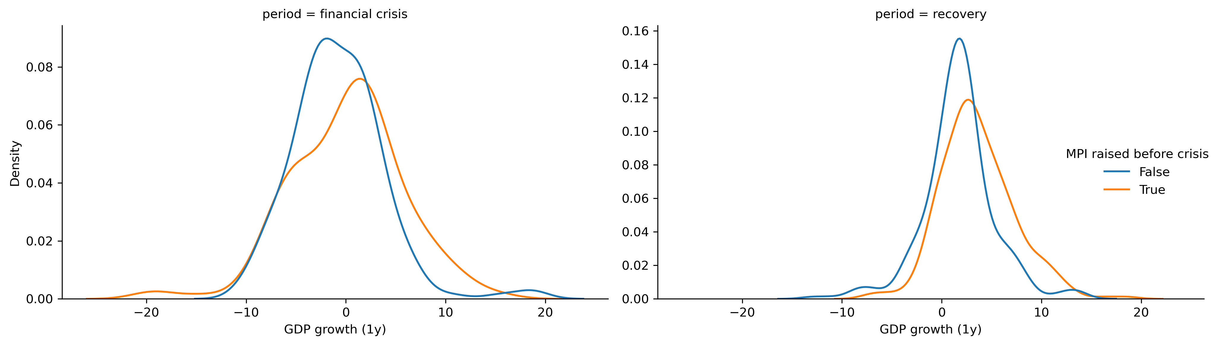
Use of Macroprudential policy in other countries
Due to data limitations in Armenia, we have also review the use of MP in other countries.
Over time the policymakers increased the usage of MP tools. Mainly it has been restrictive, except for crisis periods (2008, 2020 etc.)

Slide 16
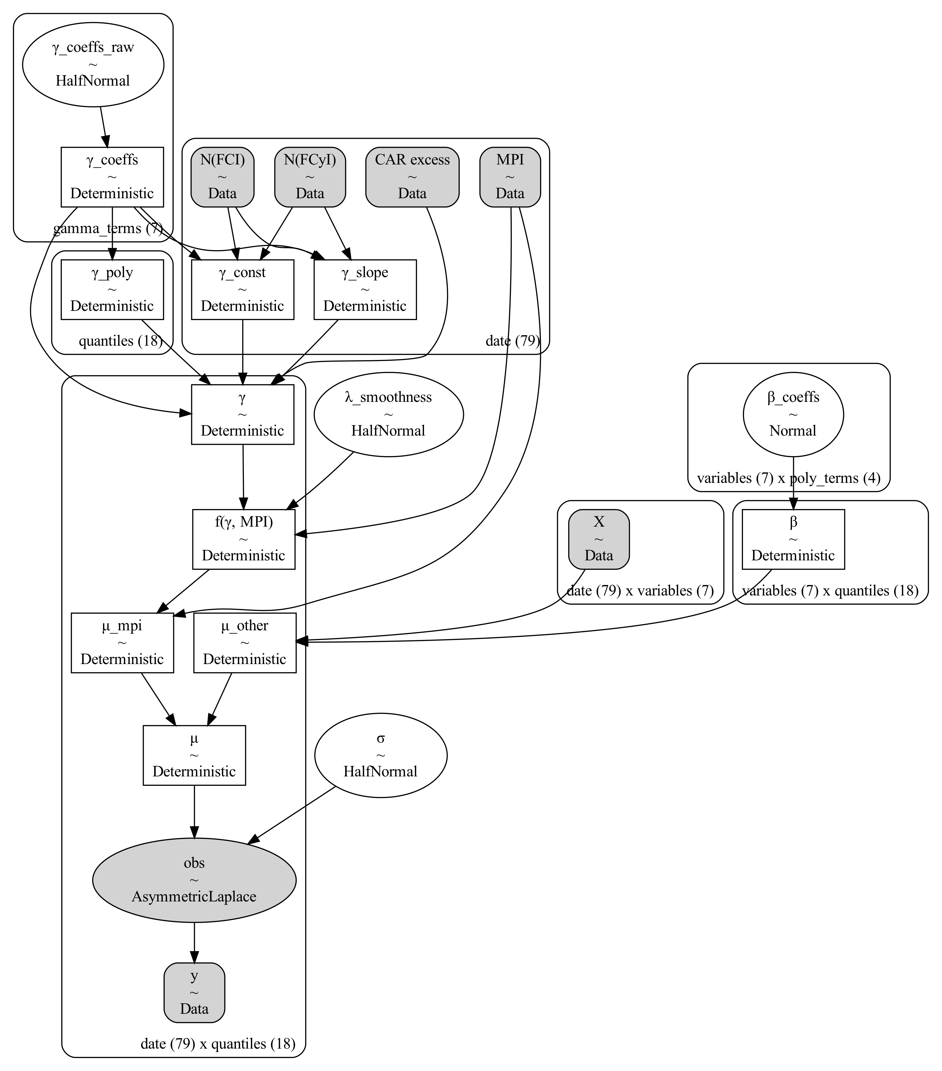
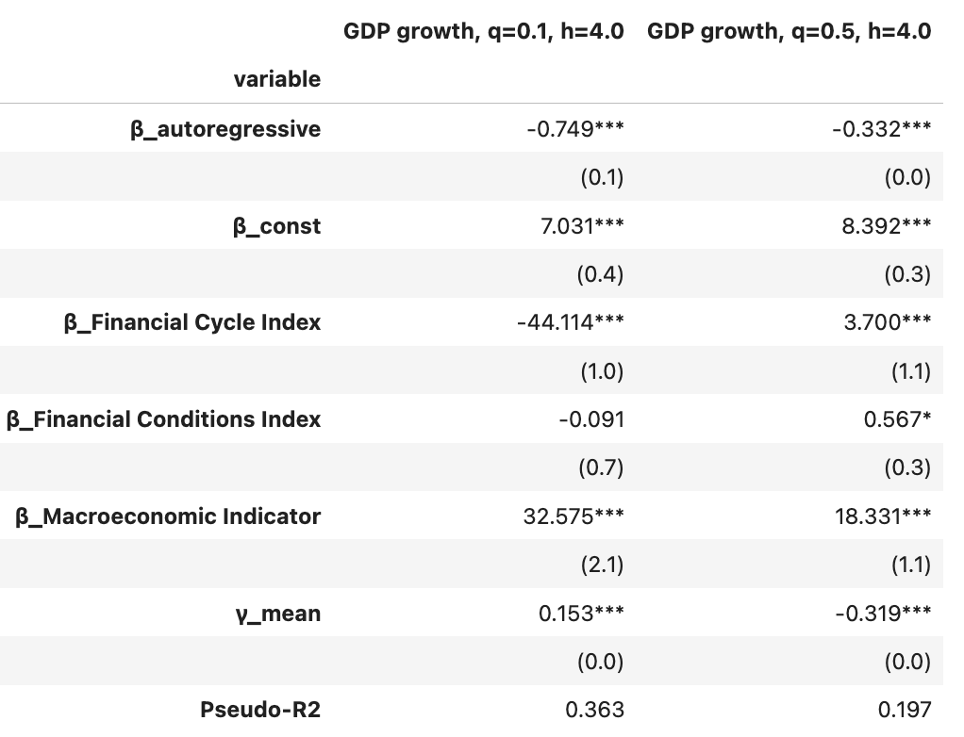
Modeling policy effects with Markov chain Monte Carlo (MCMC)

Slide 17
Effect of financial cycles and conditions on growth
The FCyI and FCI have nonlinear effects on growth:
FCyI: An increase in the financial cycle has positive effects on median growth, yet it also indicates an increase in financial vulnerabilities. These vulnerabilities can have adverse effects on growth if they materialize, as such, their impact on the tail of the distribution is negative.
FCI: The financial conditions have a positive relationship with median growth. This is largely motivated by the fact that financial stress is followed by an improvement of growth, since growth during stress is relatively lower. Additionally, the effect of current stress on future materialization of risks is negative, yet statistically insignificant.

Slide 18
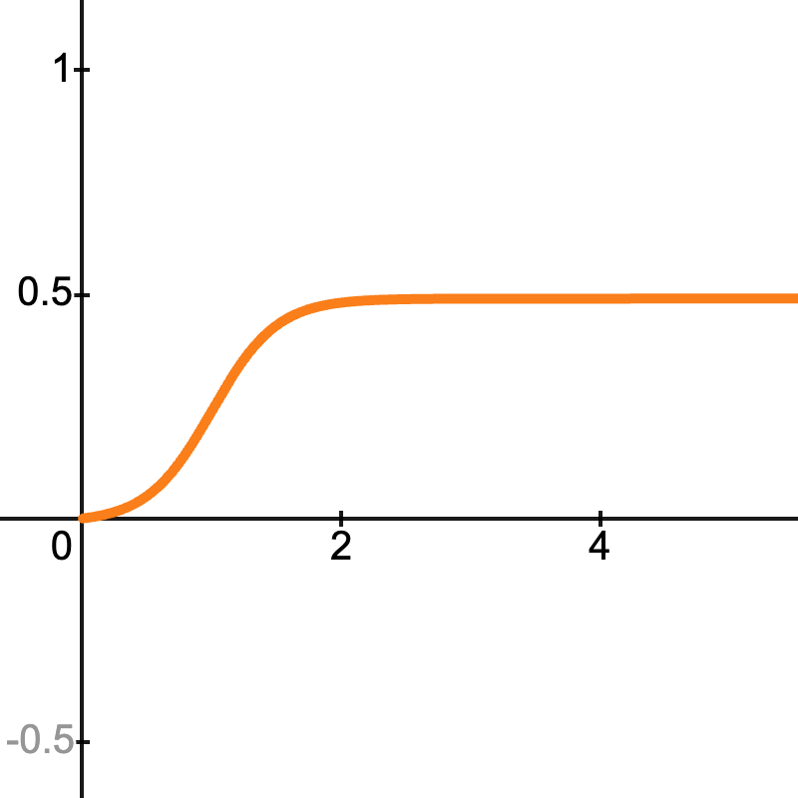
Measuring the effects of macroprudential policy
Macroprudential policy has nonlinear effects on growth. These effects can be different depending on the current level of FCyI, FCI and excess CAR.
FCyI: The greater the build-up of financial vulnerabilities, the more impactful a tightening policy will be.
FCI: A loosening policy is more effective during periods of strong financial stress. Additionally, during periods of low financial stress the negative effect of a tightening on the median is much lower.
excess CAR: Banks with CAR values closer to the minimum requirement will respond more strongly to changes in CCyB compared with banks with higher excess CAR.
Endogeneity: A policy action involving one large step usually results in stronger outcome compared to using multiple small steps (it is greater than the sum of its parts).

Slide 19
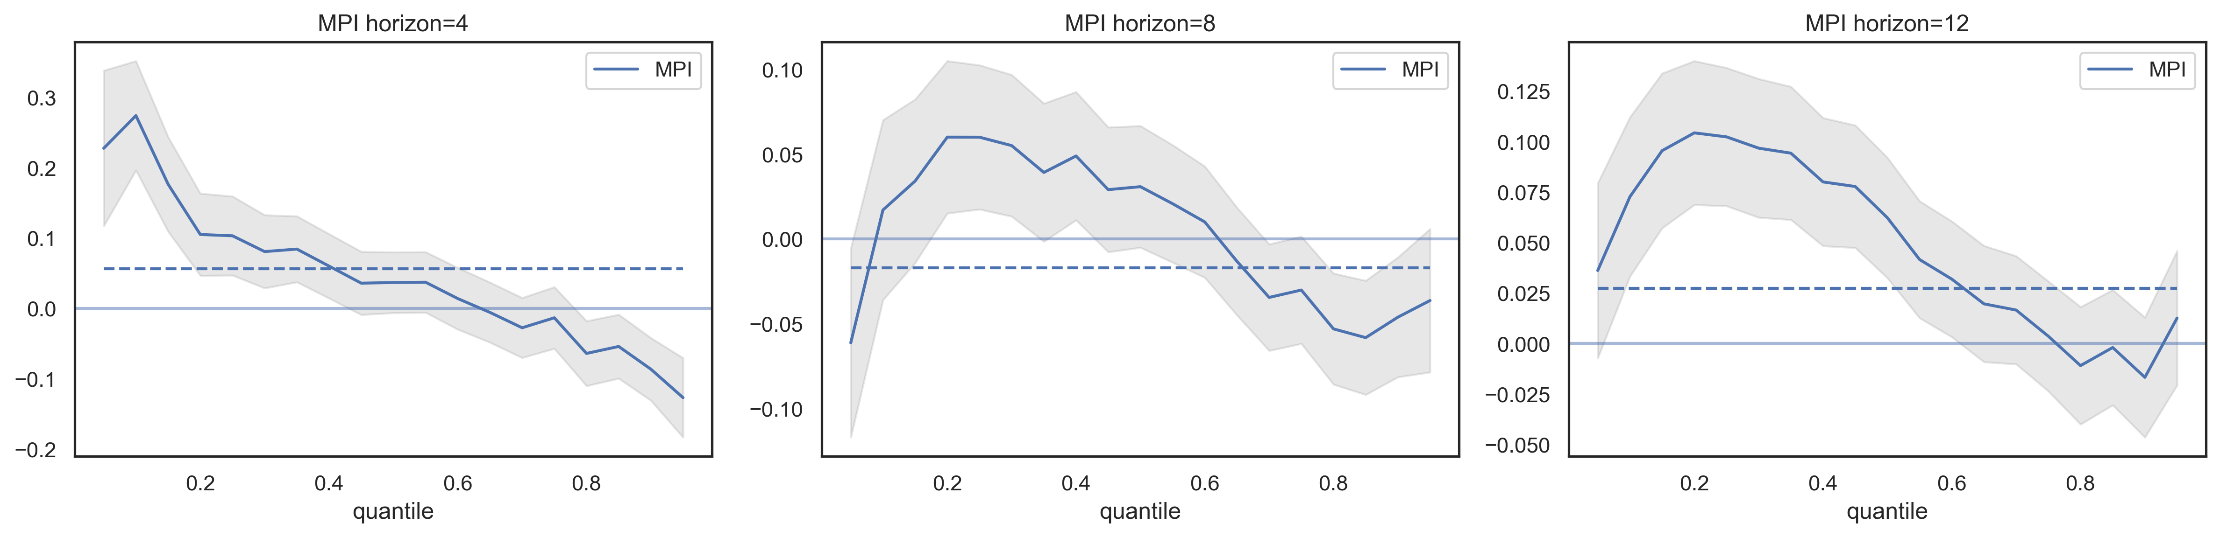
Panel estimation results: The effect of MPI
In the short-run the tightening of MP mitigates the systemic risks (the left tail shrinkage), and has an insignificant impact on the median. A similar pattern can be observed for the long run effects.

Slide 20
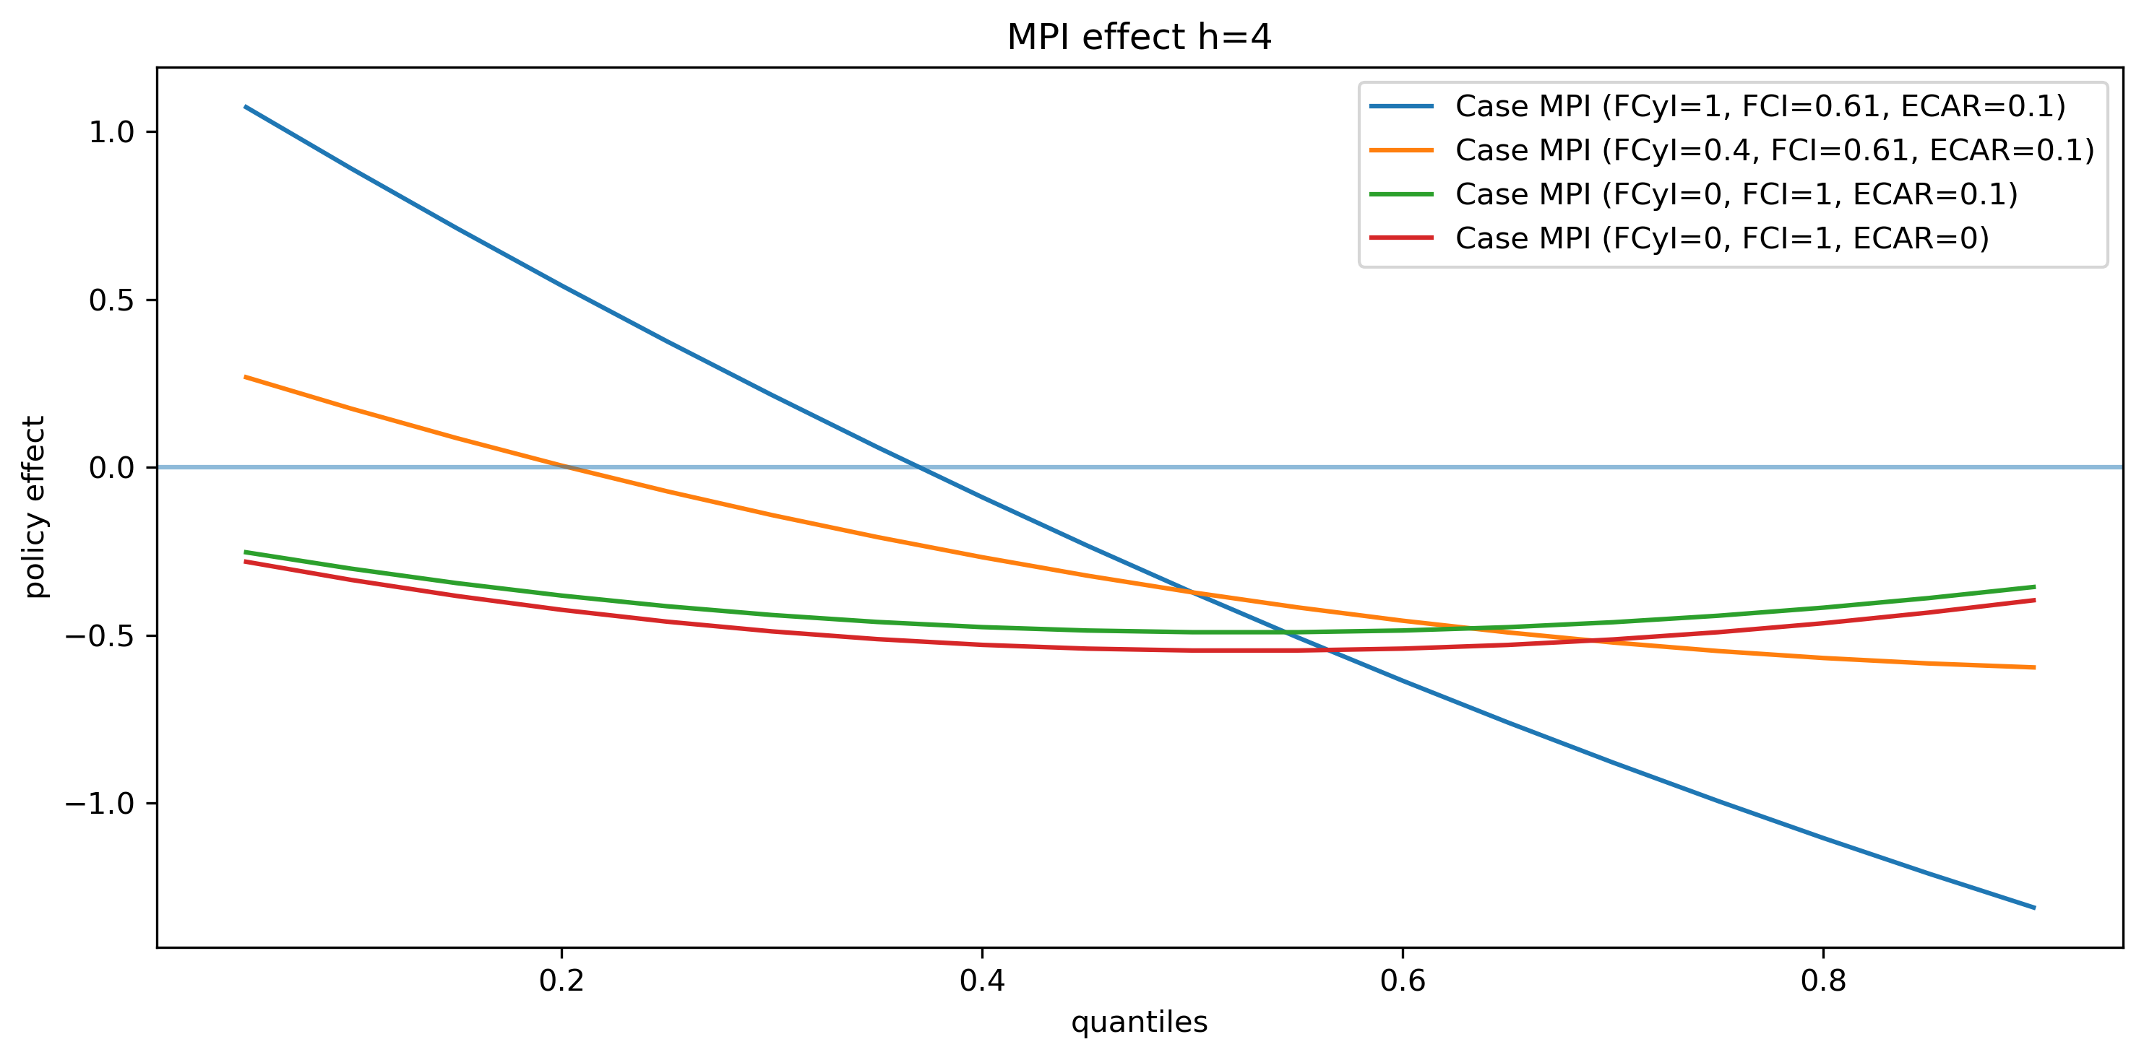
Effectiveness of macroprudential policy
We display the effects of macroprudential policy through different phases of the financial cycle in the figure below. The cases include: maturity, expansion, recession, recession without stress and severe recession.

Slide 21
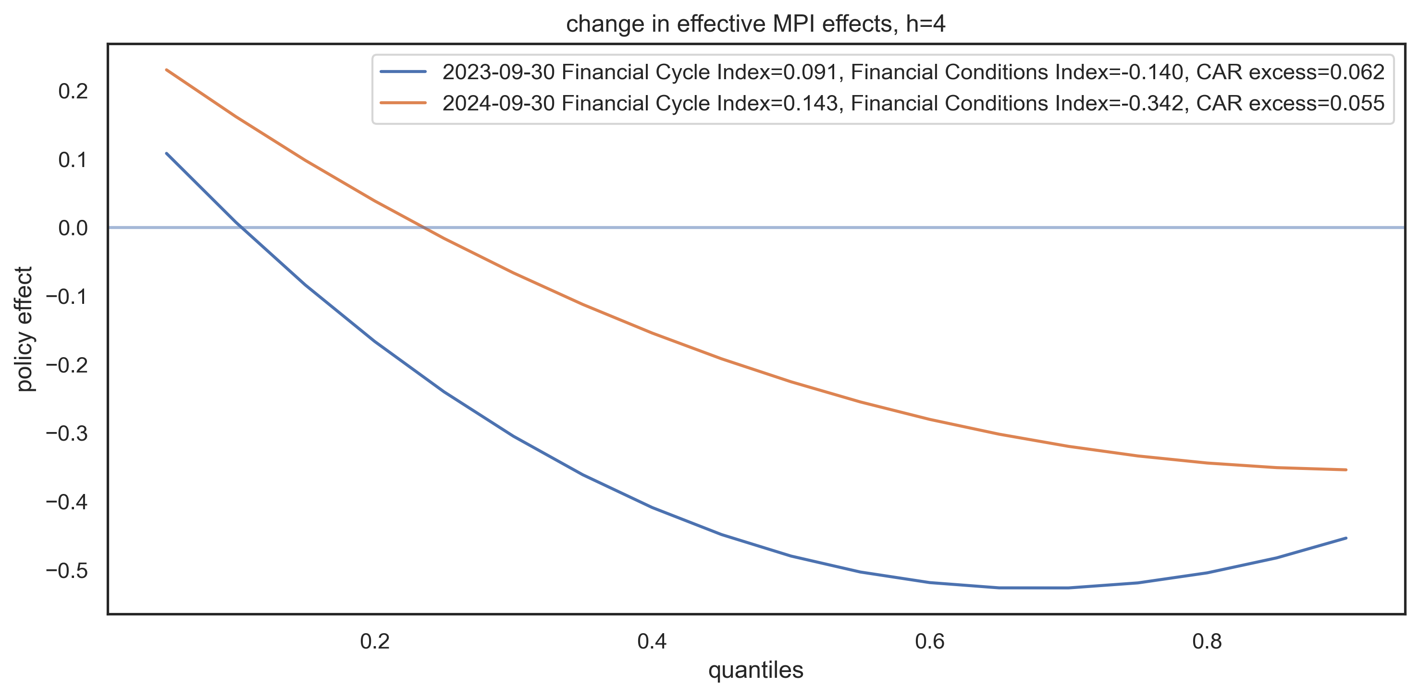
Effectiveness of macroprudential policy
Macroprudential policy has different effects depending on the quantile of the GDP growth distribution. Usually this effect is positive for the tail and negative for the median, but the outcome changes over time, conditional on FCyI, FCI and CAR.

Slide 22
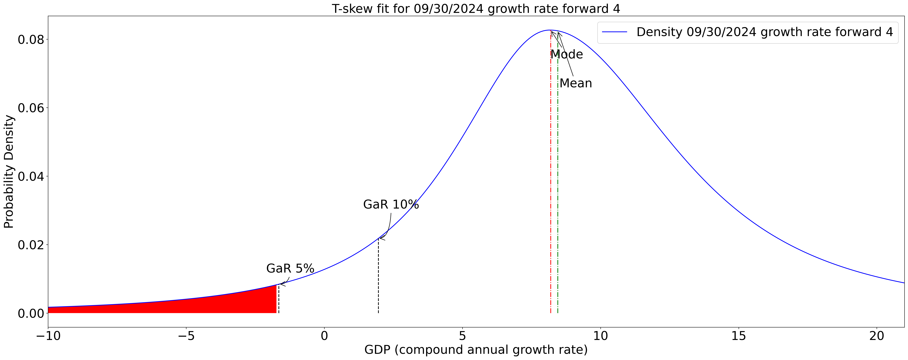
Systemic risks today
The one year ahead GDP growth distribution given risks today has a median of around 9%. The 10% GaR is at 1%. Thusly, the distance-to-tail is 8%. We can also observe that the distribution is left skewed.

Slide 23
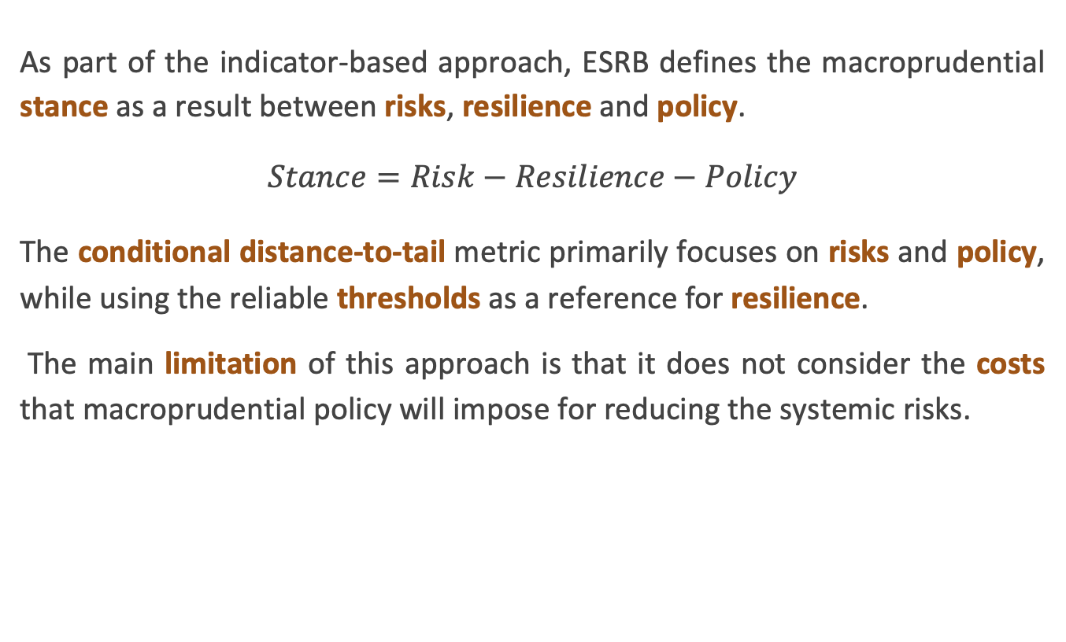
Macroprudential stance extensions
As part of the indicator-based approach, ESRB defines the macroprudential stance as a result between risks, resilience and policy.
$$Stance=Risk−Resilience−Policy$$
The conditional distance-to-tail metric primarily focuses on risks and policy, while using the reliable thresholds as a reference for resilience.
The main limitation of this approach is that it does not consider the costs that macroprudential policy will impose for reducing the systemic risks.

Slide 24
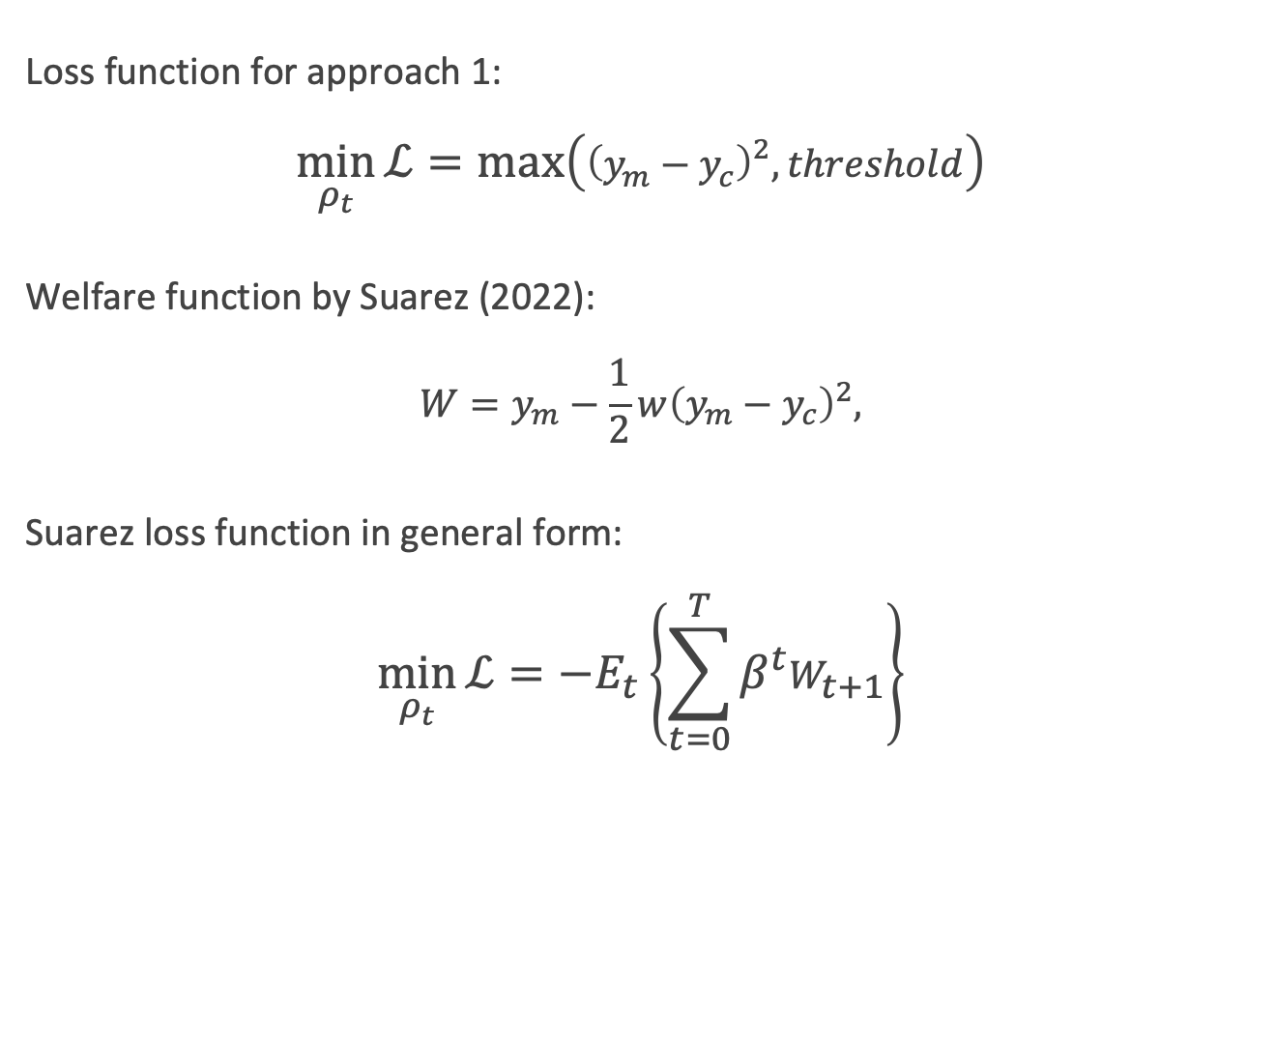
Macroprudential stance extensions
Loss function for approach 1:
$$\min_{ρ_{t}}{\text{ℒ}}=\max\left({\left(y_{m}−y_{c}\right)}^{2},threshold\right)$$
Welfare function by Suarez (2022):
$$W=y_{m}−\frac{1}{2}w{\left(y_{m}−y_{c}\right)}^{2},$$
Suarez loss function in general form:
$$\min_{ρ_{t}}{\text{ℒ}}=−E_{t}\left\{\sum_{t=0}^{T}{β^{t}W_{t+1}}\right\}$$

Slide 25
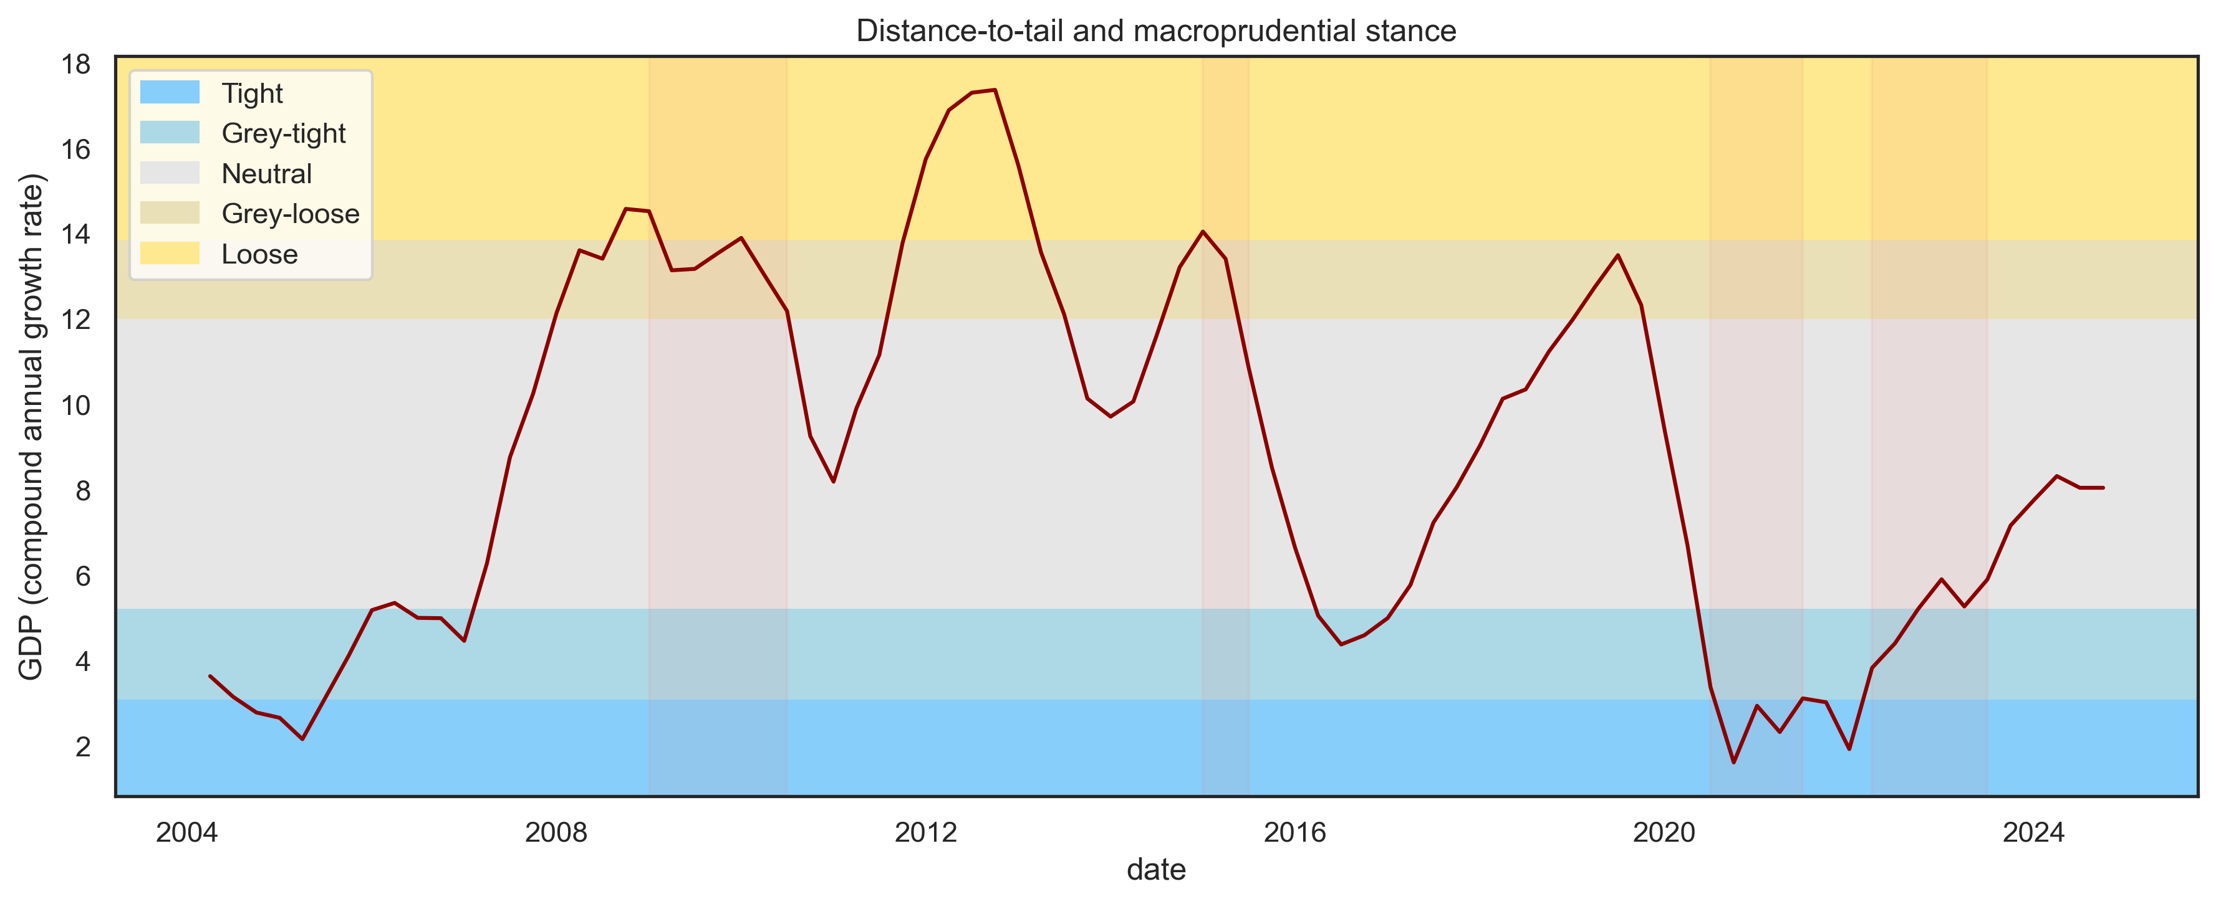
Macroprudential stance
The distance-to-tail metric allows the policymaker to monitor the overall level of systemic risks and respond accordingly to them. The ESRB recommends on comparing them to the resilience of the financial system to facilitate better policy decisions. Currently, systemic risks are at the neutral level, still they display positive trend.

Slide 26
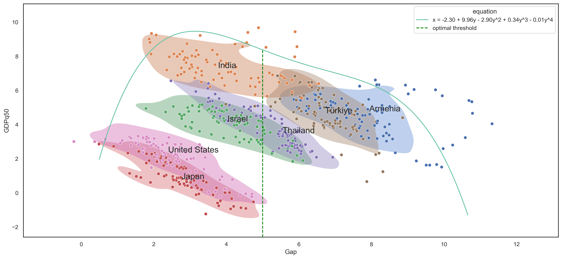
Country cases that shape the boundary
According to the estimations, beyond the 5% GDP shortfall, additional risk-taking is suboptimal. Countries should aim to manage their risks so that it is less than this threshold.

Slide 27
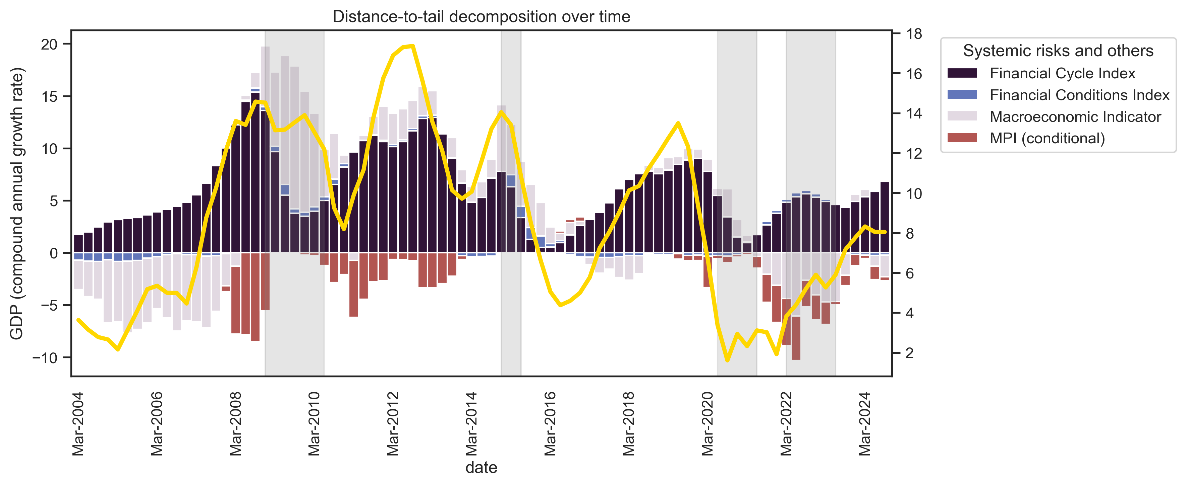
Systemic risks over time
The conditional distance-to-tail allows us to quantify systemic risks and to track them over time. This framework also allows for the decomposition of risks into various types, providing policymakers with the ability to choose instruments more selectively.

Slide 28
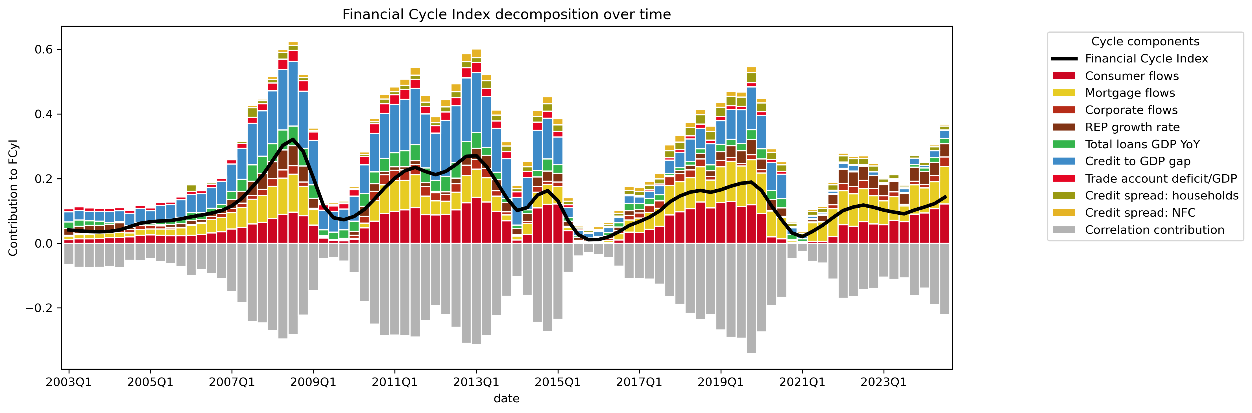
Financial Cycle Index
The FCyI reflects the build-up of systemic risks in the financial system over the medium-to-long term. It measures the accumulation of financial imbalances that could lead to crises or severe downturns.

Slide 29
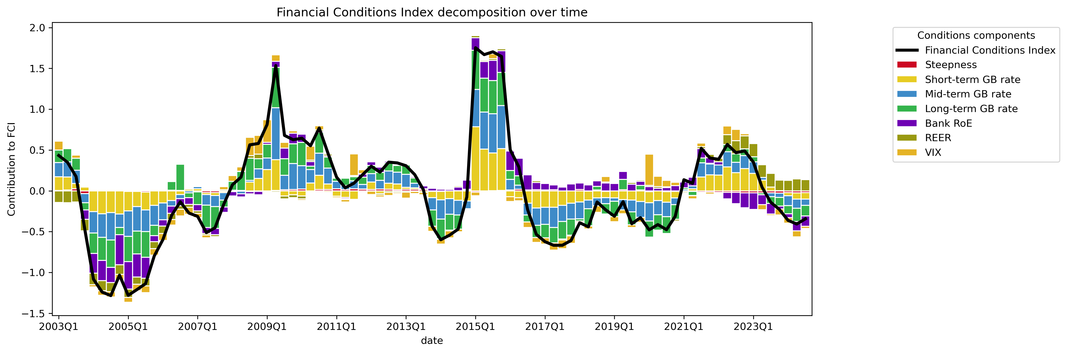
Financial Conditions Index
The FCI captures the current state of financial markets, including the ease or difficulty with which economic agents can access credit and financing (Aikman 2019). It reflects the short-term financial stress or risk levels in the system (ESRB 2021).

Slide 30
Macroprudential stance extensions
Loss function for approach 1:
$$\min_{ρ_{t}}{\text{ℒ}}=\max\left({\left(y_{m}−y_{c}\right)}^{2},threshold\right)$$
Welfare function by Suarez (2022):
$$W=y_{m}−\frac{1}{2}w{\left(y_{m}−y_{c}\right)}^{2},$$
Suarez loss function in general form:
$$\min_{ρ_{t}}{\text{ℒ}}=−E_{t}\left\{\sum_{t=0}^{T}{β^{t}W_{t+1}}\right\}$$

Slide 31
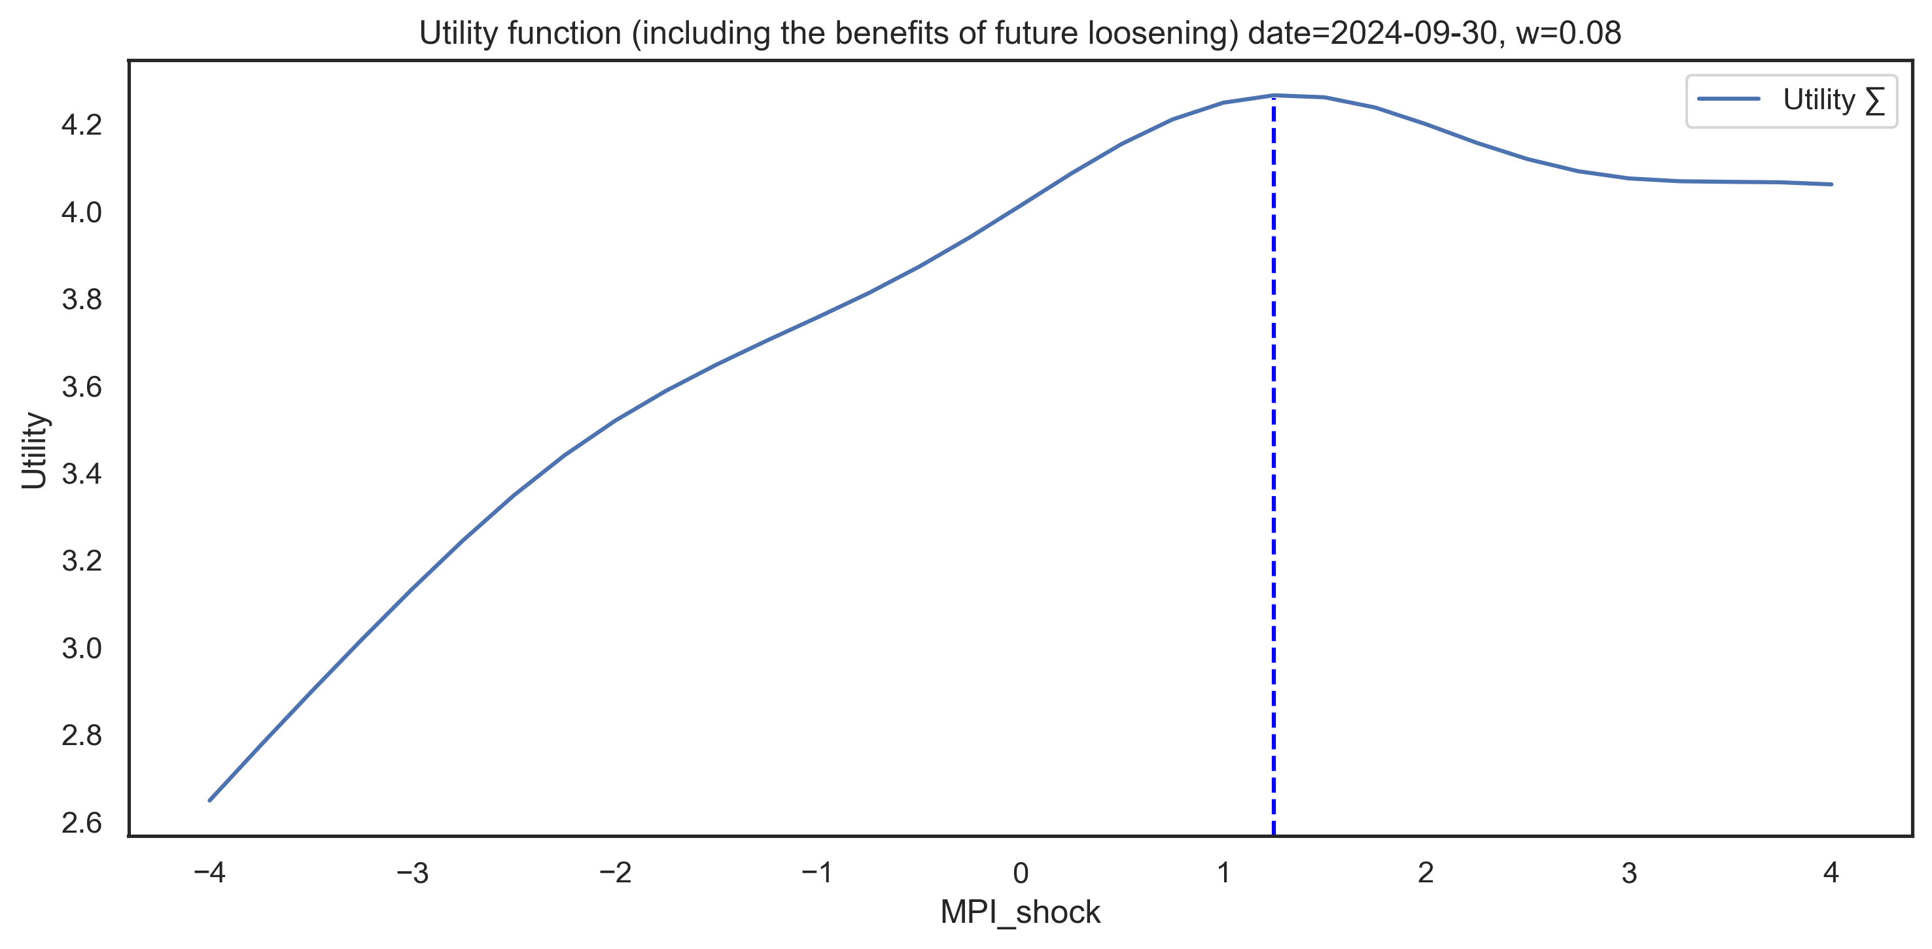
w calibration: Suarez utility function
The Suarez utility function indicates preference for a particular policy action given the policy stance and risk expectations w. Higher values of utility indicate preference towards those polices.

Slide 32
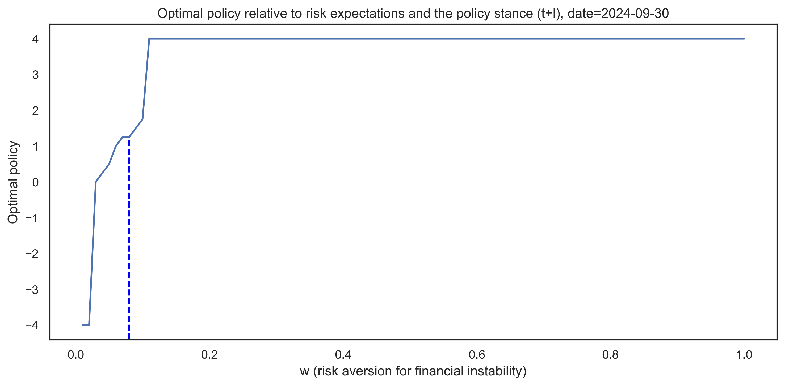
w calibration: Risk aversion interval relevant for policy decisions
w represents the policy stance and risk expectations of the policymaker. As such, it should change slowly over the financial cycle. If the policymaker believes there is a fundamental change in risks, then they should change w accordingly.

Slide 33
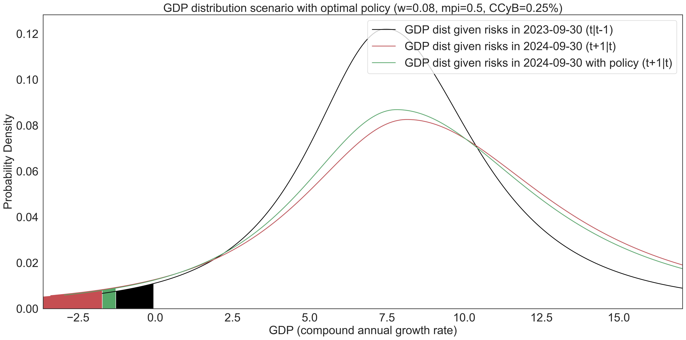
GDP distributions corresponding to systemic risks one year prior. Median: 9.21% --> 8.9% (-0.31%), Gap: 7.93% --> 7.39% (-0.54%).

Slide 34
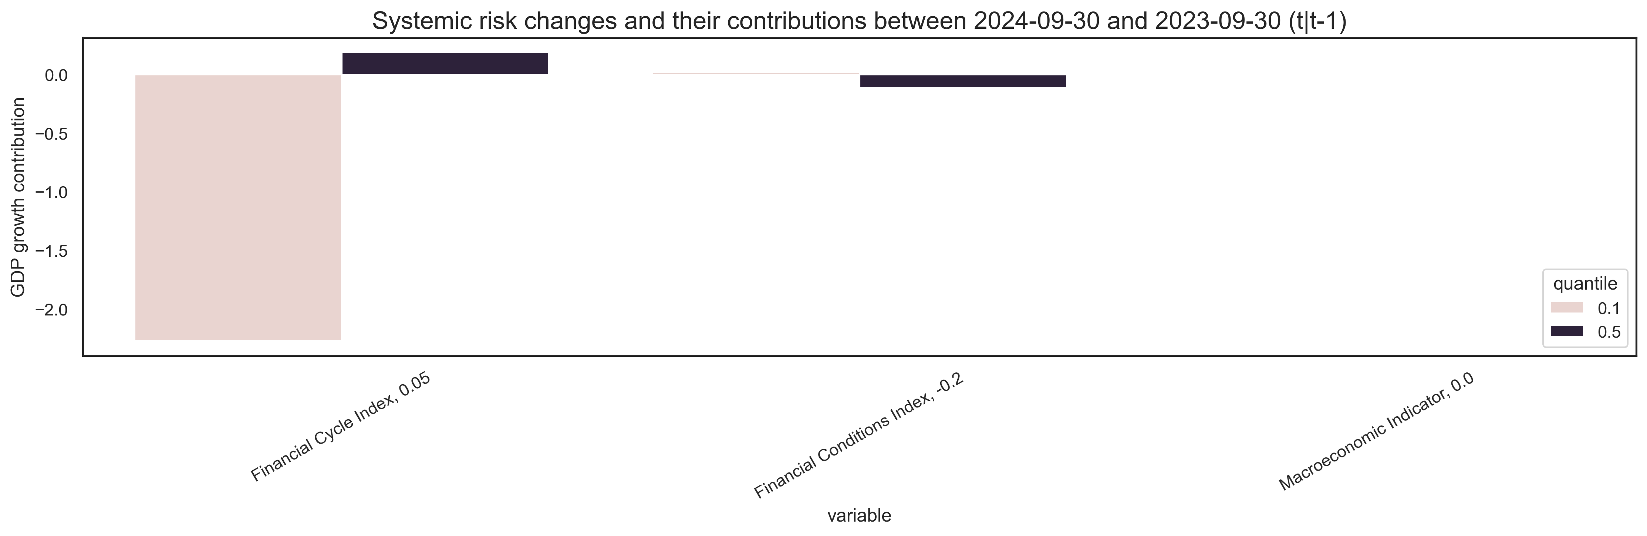
Risks' contribution to expected median and tail
Major risks stem from increasing financial cycles. Additionally, negative externalities may exacerbate these risks through indirect channels.

Slide 35
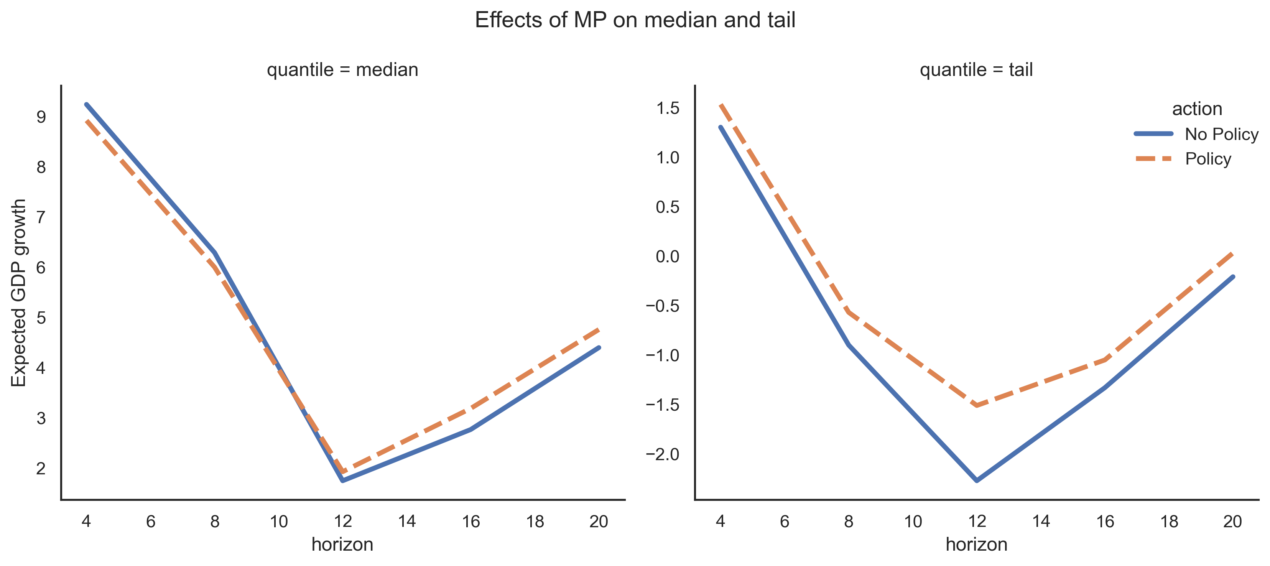
Macroprudential policy outcomes
The policy introduces a trade-off between the short-term costs of tightening and future benefits of loosening. Additionally, it introduces long-term benefits in the tail of the distribution, improving it, especially during crisis episodes.

Slide 36
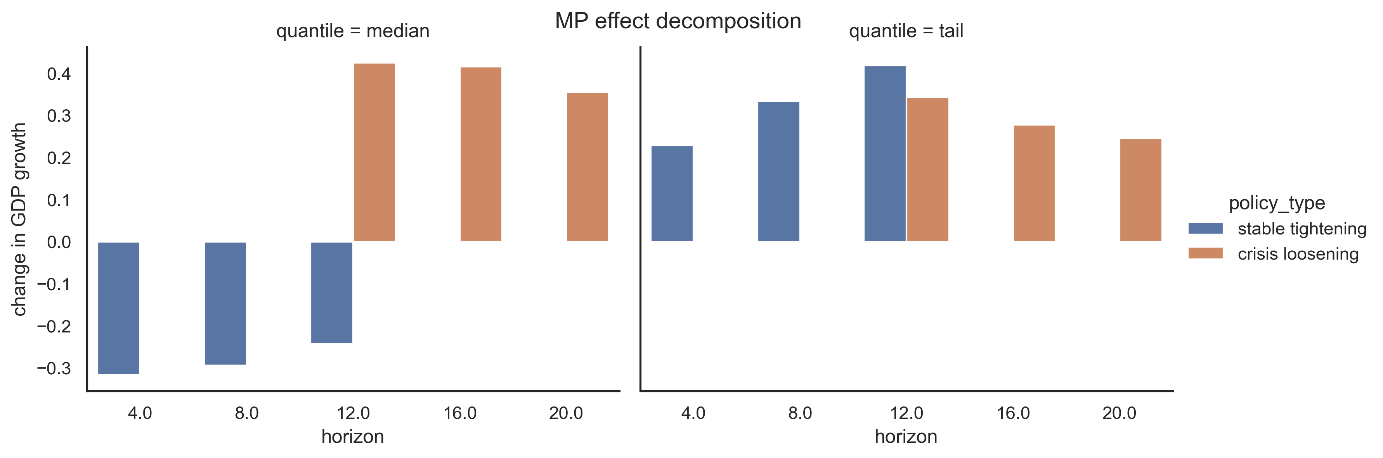
Macroprudential policy: effect decomposition
The effect assessment of macroprudential policy accounts for the impact of tightening actions today and loosening actions in the future by an equivalent amount. The Suarez utility function is used to compare the present value of benefits for different policy actions to select the policy with the most benefits.

Slide 37
Limitations
Endogeneity – subject to “reverse causality,” and reduced-form regressions cannot estimate the endogenous changes
Transmission channels – econometrics methods are unable to model transmission mechanisms, specifically how the MP effects will propagate through the financial system to the real economy.
Limited data
MPI is an aggregate indicator – as a result of generalization, the specific effects of the MP instruments are lost. MPI is better suited for determining the direction of MP, but the specific tool or the magnitude of the policy action.

Slide 38
Recommendation

Slide 39
Conclusion
This project aims to quantify systemic risks and the effects of macroprudential policy on them, through the use of empirical growth-at-risk (GaR) frameworks.
It aims to augment the process of decision-making by proposing methods for designing a policy rule for macroprudential policy.
This rule shouldn't be viewed as a binding constraint, but rather as guideline that could serve as a basis for preemptive action.

Slide 40
Thank you

